Slide 1
UNIT 8: PLACES
Section A – Asking the way
(A1, A2, A3)
(text book / page 79-82)

Slide 2
Objectives
By the end of the lesson, you can:
+ Ask and answer about the way
+ Talk about directions
+ Use the prepositions

Slide 3
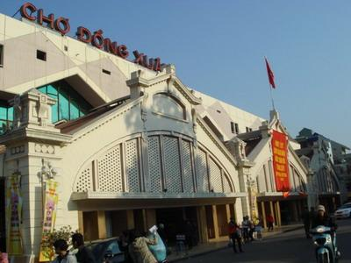
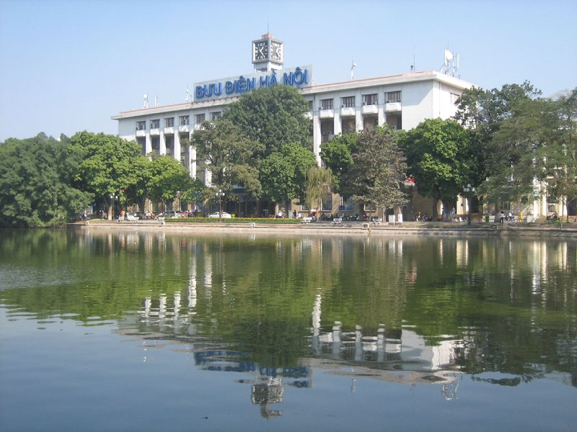
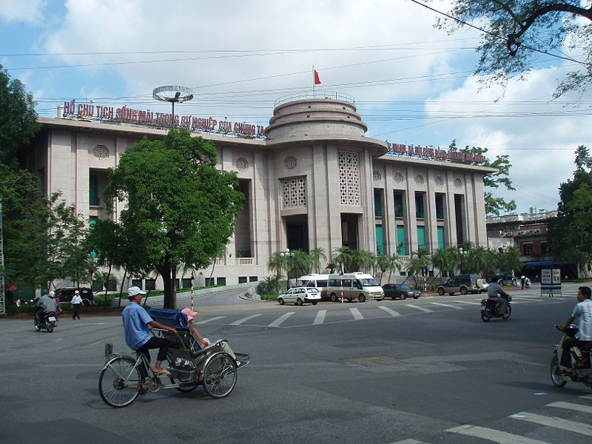
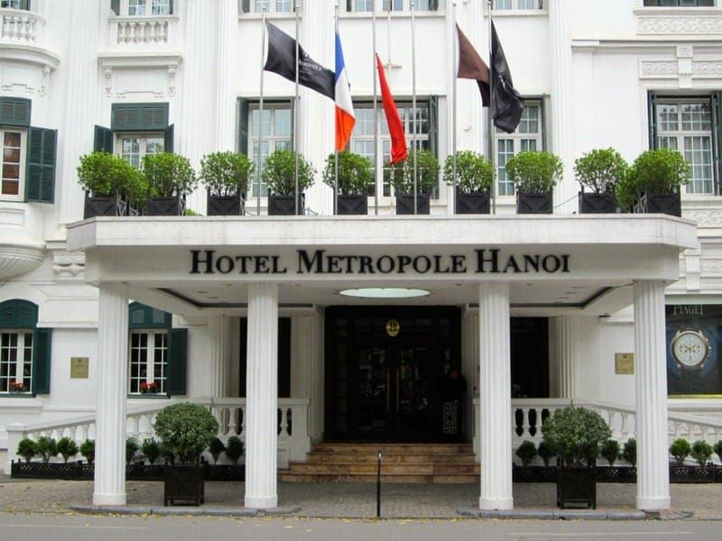
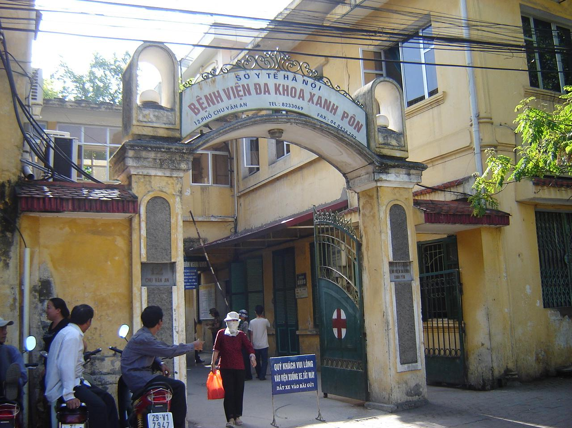
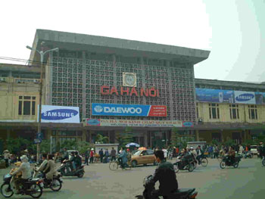
Matching :
1. Dong Xuan market
Picture 1
Picture 4
2. Sofitel Metropole Hotel
3. National Bank of VN
Picture 2
4. Saint Paul Hospital
Picture 5
5. The Central Post Office
6. Ha Noi Railway Station
Picture 3
Picture 6

Slide 4
NEW WORDS:
01
tourist (n)
khách du lịch
02
souvenir shop (n)
cửa hàng bán đồ lưu niệm
03
đi thẳng
04
go straight ahead
05
take the first street:
rẽ ở con đường thứ nhất
06
take the second street
rẽ ở con đường thứ hai
take the third street:
rẽ ở con đường thứ ba

Slide 5
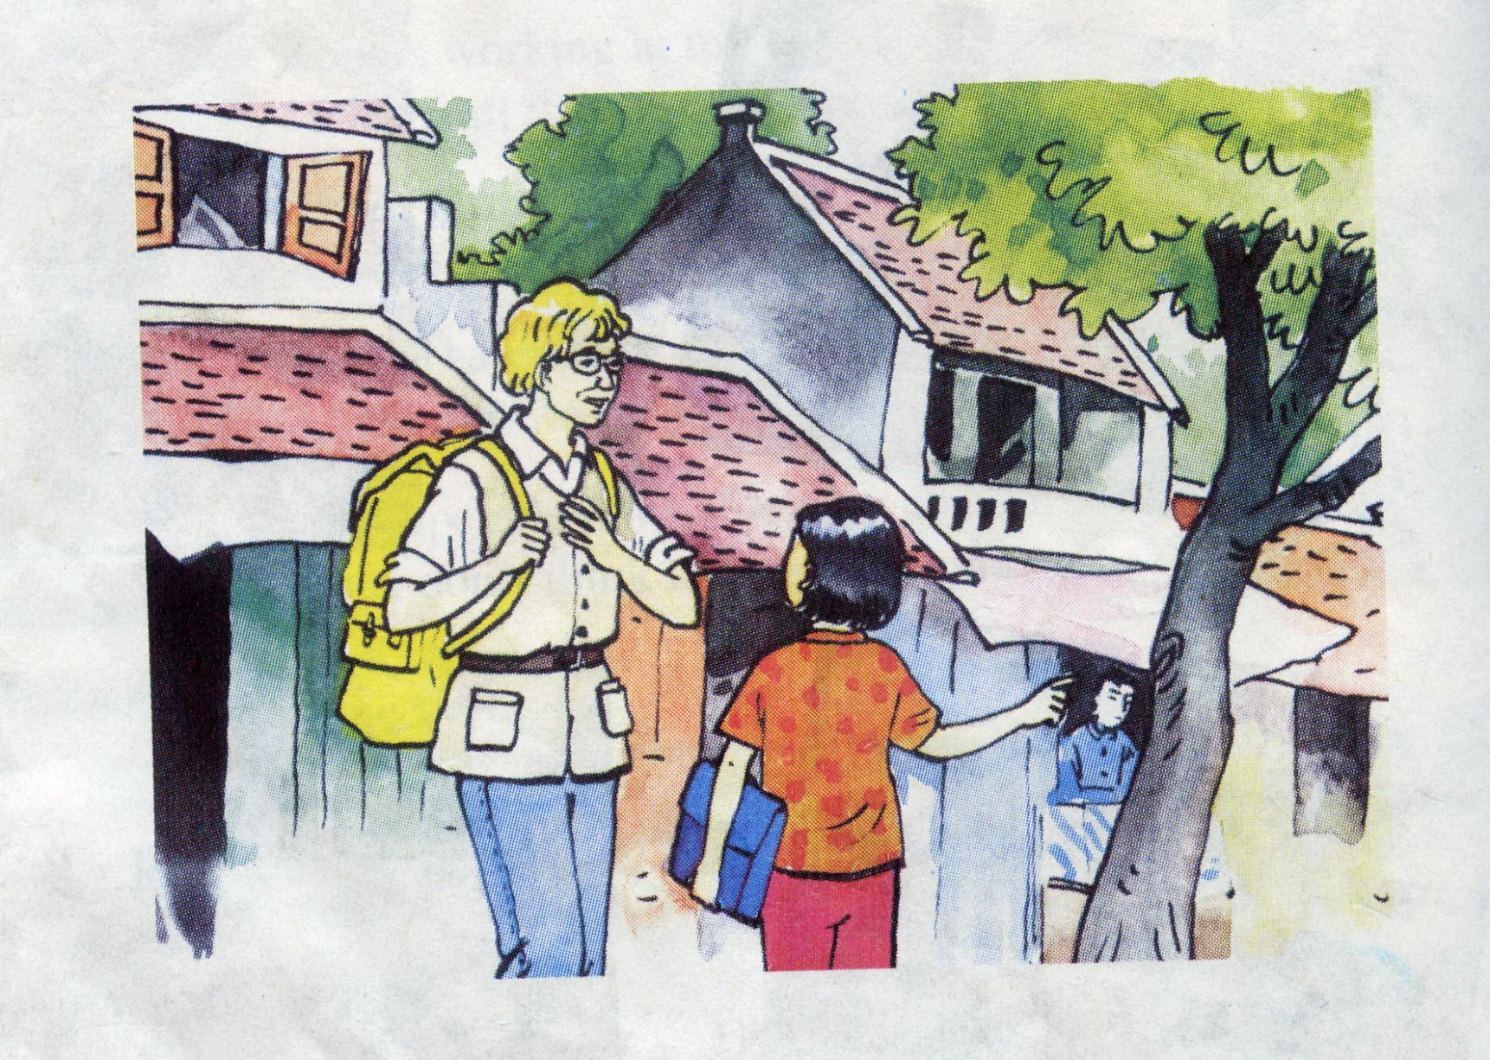
A 2.Listen and repeat. Then practice the dialogue with a partner
They are asking and answering about the way.
Tourist
Nga

Slide 6
A2. Listen and repeat:
a) Tourist: Excuse me. Is there a souvenir shop near here?
Nga: Yes. There is one on Hang Bai street.
Tourist: Could you tell me how to get there?
Nga: Go straight ahead. Take the second street on the left. The souvenir shop is on the right, opposite the post office.
Tourist: Thank you.
Nga: You’re welcome.
b) Tourist: Excuse me. Could you show me the way to the supermarket, please?
Nga: The supermarket? OK. Go straight ahead. Take the first street on the right. The supermarket is in front of you.
Tourist: Thanks a lot.
Nga: You’re welcome.

Slide 7
A3. Look at the street map. Practice the dialogue with a partner
BAKERY
HOSPITAL
RESTAURANT
FACTORY
TOY STORE
SUPERMARKET
BANK
SHOE STORE
MOVIE THEATER
DRUGSTORE
RESTAURANT
HOTEL
PARK
MARKET
SOUVENIR SHOP
POST OFFICE
STADIUM
POLICE STATION
SCHOOL
BOOKSTORE
MUSEUM

Slide 8
Thanks for your attention!

